Slide 1


Stress Measurement Network
Mission
To better understand the relationship between stress and health by improving the measurement of psychosocial stress in research studies
Leadership team
Elissa Epel, Co-Director, UCSF
Wendy Berry Mendes, Co-Director, UCSF
Lis Nielsen, NIA
Aric Prather, Associate Director, UCSF
George Slavich, Associate Director, UCLA
Alexandra Crosswell, Executive Director, UCSF
Notes:
The proposed network will put forth an empirically supported new taxonomy for understanding stress through a lifespan approach (Aim 1), attempting to characterize the important dimensions to measure, conceptually and methodologically. Having a common vocabulary and measurement batteries would promote scientific progress in understanding stress and its relationship to health in aging

Slide 2
Network Aims
Conduct original research by funding pilot and validation studies to develop and refine stress measurement tools;
Create a “toolbox” of expert recommended stress measurement tools, which will include the development of a short measure of stress suitable for population-based studies;
Harmonize measures of stress across large scale studies, and facilitate the addition of new measures into ongoing population-based studies.
Notes:
The proposed network will put forth an empirically supported new taxonomy for understanding stress through a lifespan approach (Aim 1), attempting to characterize the important dimensions to measure, conceptually and methodologically. Having a common vocabulary and measurement batteries would promote scientific progress in understanding stress and its relationship to health in aging

Slide 3
Pilot Studies
6 funded studies in 2015
Stress predictors of health in the Health and Retirement Study (Dr. Eli Puterman)
Stress predictors and stress in MIDUS (Dr. Joshua Wiley)
Self-reported measures of stress and resting state connectivity in intrinsic networks (Drs. Pete Gianaros and Tor Wagner)
The Stress of Food Security – A Need for a New Measure (Dr. Cindy Leung)
Development of an Implicit Association Test to Measure Chronic Stress (Dr. Chris Crew)
Examination of the Subjective Stress in Context (SSiC) Measure in a Highly Stress Sample: Qualitative Interviews with Individuals in the Federal Justice System (Alyssa Mooney, PhD student)

Slide 4
Pilot Studies
8 funded studies in 2016
Development of a standard protocol for the assessment of stress-related vocal responding (Drs. Brian Baucom & Paula Williams)
Assessing stress with mobile passive sensing behavioral data (Drs. Michelle Byrne, Nicholas Allen, Monika Lind)
Developing an automated scoring system for the LEAP (Drs. Kamarck & Anderson)
Text-message based emotion tracking app (EmoTrak) with UCSF residents to examine how the subjective experience of emotion relates to daily and chrnoic stress and burn out (Dr. Eve Ekman)
Cardiovascular and hemodynamic reactivity to stress: Validity and reliability of new wearable device for assessing stress reactivity (Dr. Kira Birditt)
Stress activation of neurocircuits, hippocampal metabolities, and cognitive function: A combined fMRI, MRS, and HPA-axis function study (Dr. Juliet Kroll)
Cumulative stress across the lifespan as a mechanisms for SES-related health disparities (Drs. Stacey Scott, Goerge Slavich, Martin Sliwinski)
Measuring caregiver burden and use of app-based technology in Alzheimer’s caregivers

Slide 5
Pilot Studies
6 funded studies in 2015
Two examining stress predictors in population based studies (HRS and MIDUS)
Three new measurement development studies
One experimental study of self-reported stress and resting state connectivity in intrinsic networks
8 funded studies in 2016
Implementation of new technologies in stress measurement (e.g. mobile passive sensing data; daily emotion tracking app)
Novel stress measurement techniques (e.g. vocal responding)
Efforts to improve automation of existing measures (e.g. automated scoring for the LEAP)
Focus on high stress sample (i.e. residents, Alzheimer’s disease caregivers, and low SES sample)

Slide 6
Measure Development
Goals
  Develop a brief measure of stress, focusing on key types of stressful experiences, ‘baking in’ context and perception
  Easy to integrate into studies for investigators & easy to use for participants
  Strong predictor of health and aging-related outcomes at different units of analysis, especially cognitive aging, disease onset, and mortality… and biomarkers related to these outcomes
  Generate actionable, policy-relevant data

Slide 7
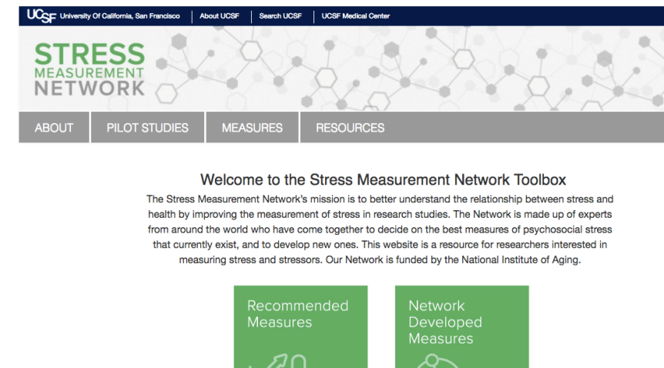
Online Toolbox
What short measures do we recommend epi studies include to capture experiences of stress across the lifespan
What are the recommended measures for different domains of stress, and why?
E.g. what is the recommended measure for early life stress?
http://stresscenter.ucsf.edu/

Slide 8
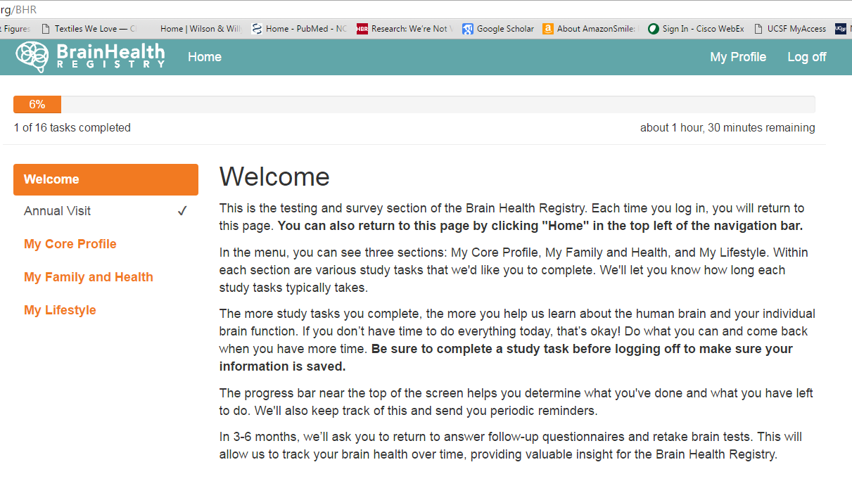
Brain Health Registry (n=30k+ US adults, tracking cognition every 6 months)
Core Stress Module

Slide 9
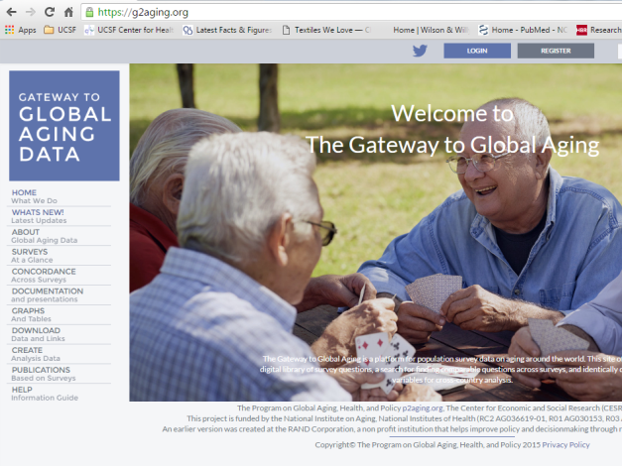
Health and Retirement Study Harmonization Project
Jinkook Lee & Tara Gruenewald, USC

Slide 10
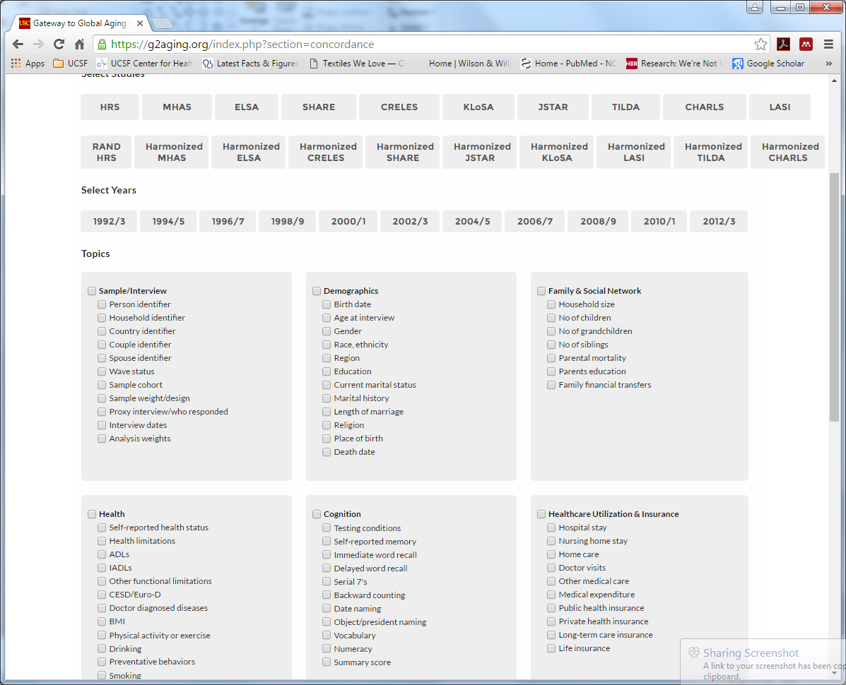
Stress
Early life stress
Chronic stress
Relationship stress
Financial stress

Slide 11
Organization of Today’s Presentation
Commentary on Kagan’s Psych Perspectives
Acute stress response – Wendy
Chronic stress – Elissa
Practical improvements – George

Slide 12
Stress Battery v1.0
List of domains
Chronic health conditions and other chronic stressors
Traumatic experiences
Early life stress
Discrimination
Work stress
Interpersonal stress: Loneliness, social isolation, relationship conflict, & caregiving
Financial strain: Social status, adult SES, childhood SES, & financial strain
Neighborhood safety & cohesion
Moderators/Resilience: Social support, personal control, satisfaction with life, optimism

Slide 13
Solution?
1) Restrict to serious events that compromise health
“Toxic stress”
Role of individual differences?
2) Reduce ambiguity of the stress concept by specifying:
Sociodemographics: sex, ethnicity, SES
Developmental stage,
event/stimuli (stressor)
predictability and controllability (appraisal)

Slide 14
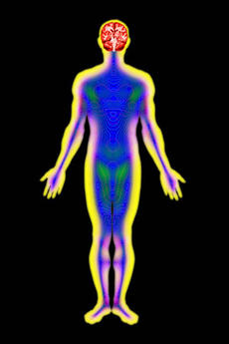
“Stress” concept: Distributed between self, others, and environment
Environment
Brain
& Body
Mind
Stress is a dynamic emergent process (verb, not a noun)
Cannot be fully reduced
Notes:
Can’t rely so much on languge
Have contexts that are powerful (poliictal, instab, war, status of women)

Slide 15
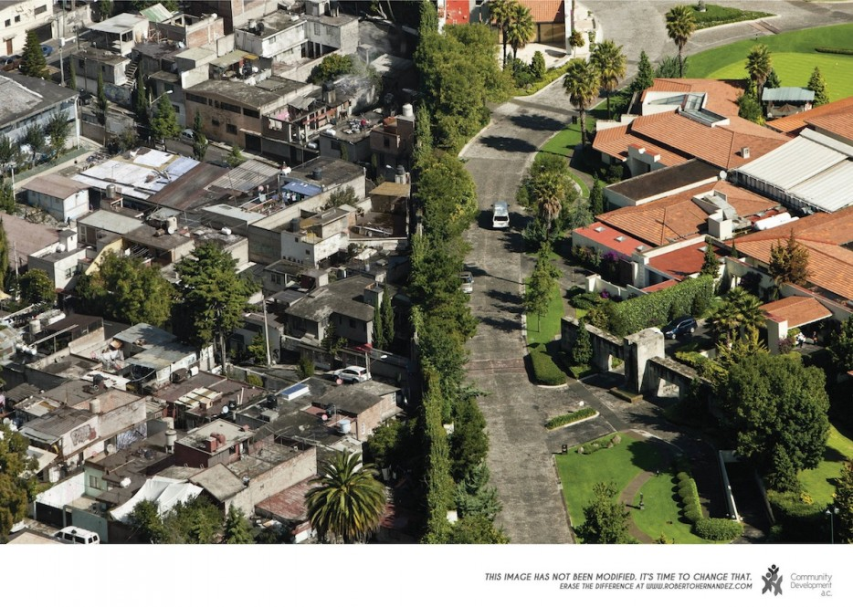

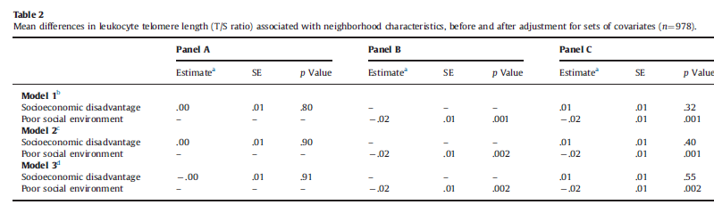
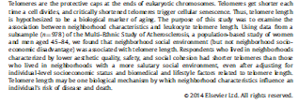

Slide 16
Chronic vs. acute stress
Chronic stress exposure
Acute stress
Expectations of justice
Biological embedding
  Changes in corticolimbic pathways and responses
Context shapes response
  People
  Stimuli
  Expectations
Low reliability of response
Can an acute stress assay be universal?

Slide 17
SOBC projects related to stress
Stress Targets :
Behavioral outcomes
Daily stress reactivity, recovery, pileup as stress (Almeida)
(What is stressor here?) Emotion regulation, attentional control (Loucke, Ma)
Coercive conflict and ANS (Heyman)
Sleep
smoking
Eating
Brushing teeth

